Slide 1
Human Resource Management

Slide 2
Objectives
Human Resource Management
Why do people work?
What power does a Project Manager have?
How are people motivated?
How can teams be managed?

Slide 3
Human Resource Management
Making effective use of the people involved with a project.
Four Processes:
  Human Resources Planning
    Identify and list project roles and responsibilities
  Acquiring the project team
    Getting the right people assigned to the project team.
  Developing the project team
    Building individual and group skills to enhance project performance.
  Managing the project team
    Tracking team member performance, motivating team members, providing timely feedback, resolving issues and conflicts, and coordinating changes to enhance project performance

Slide 4
Why people work
To manage people, we need to understand why they work for us in the first place.
Why do people work?
What do they need so they can work better?
Much research by psychologists and management theorists have been devoted to the field of managing people at work. Important areas related to project management include:
  Motivation theories
  Influence and power
  Effectiveness

Slide 5
Maslow’s Hierarchy of Needs
Abraham Maslow (A Theory of Human Motivation) suggested that human beings possess unique qualities that enable them to make independent choices, thus giving them control over their destiny.
He developed a hierarchy of needs, which states that people’s behaviors are guided or motivated by a sequence of needs.
These needs are arranged in layers. Bottom layer needs must be met before people are concerned with the next layer above.

Slide 6
Challenging projects,
opportunities for
innovation and creativity,
Fulfilment, creative urge, personal
Development, own free will
high
Recognition,
prestige, status
Self Respect Achievement
Reputation, appreciation, respect of others
5. Self
Actualization
Belonging, Acceptance, love,
Affection, Association
with a team/group
4. Esteem
3. Social
Physical safety
Economic
Security. Work,
Family, Society
2. Safety
Air, Food,
Water,
etc
1. Physiological
low
A satisfied need is no longer a motivator

Slide 7
Growth needs
5. Self
Actualization
4. Esteem
3. Social
Deficiency needs
2. Safety
1. Physiological
A satisfied need is no longer a motivator

Slide 8
Provides a structure allowing managers to understand whether an employees needs are being met. All or not all.
Do managers need to satisfy of an employee’s needs? Perhaps only deficiency needs need to be met at work, with growth needs met elsewhere via activities outside of work. This depends on various factors such as employee ambition, nature of job, country of work and manager’s approach.

Slide 9
Criticism
Does not appear to work in all cases
Cultural differences may lead to misapplication
Scant real-world evidence to support its application. (i.e. not scientific?).

Slide 10
Herzberg’s Motivational and Hygiene factors
Frederick Herzberg wrote in the area of worker motivation. He had a Two-Factor Theory. He distinguished between:
  Motivational factors
    Achievement, recognition, the work itself, responsibility, advancement and growth. These factors produce job satisfaction.
  Hygiene factors (Maintenance Factors)
    Larger salaries, more supervision and an attractive work environment. These factors cause dissatisfaction if not present, but do not motivate workers to do more.

Slide 11
Herzberg’s Motivational and Hygiene factors
Hygiene factors | Motivational factors
Security, Status, Relationship, Personal Life | Sense of Achievement
Larger salaries | Recognition (by managers and colleagues)
More supervision | Work itself (meaning and interesting work)
More attractive work environment | Responsibility
Computer or other required equipment | Advancement
Health benefits | Growth opportunities
Training
Company policies and administration

Slide 12
Hygiene factors must be covered before moving to the motivational factors.
Hygiene factors: reduce negative attitudes and dissatisfaction.
Motivational factors: create positive attitude and satisfaction. When used in the right way, employees can feel that they have made a difference.

Slide 13
Two-Factor Theory
Fix Company policies
Provide suitable supervision
Create a culture of respect
Competitive wages
Build job status
Provide job security
Provide opportunities for achievement and advancement
Create work
Give responsibility
Allow people to pursue their dream jobs

Slide 14
Criticism
Overlooks variables among individuals.
Assumes a correlation between satisfaction and productivity.
No measure of satisfaction was settled on.
During development this only looked at white collar workers. The factors applicable to them do not necessarily apply to other workers.

Slide 15
Intrinsic and Extrinsic Motivation
Intrinsic motivation
  Causes people to participate in an activity for their own enjoyment.
Extrinsic motivation
  Causes people to do something for a reward or to avoid a penalty

Slide 16
Intrinsic vs. Extrinsic
People are usually attracted to a job for extrinsic reasons (good pay, good benefits, good working conditions)
People usually stay with a job for intrinsic reasons (they like the people they work with, they find the job challenging, people praise them for the work they do)
Paying people more money (extrinsic motivation) does not make them work harder. But it might keep them from leaving and it might attract new employees)
Intrinsic motivation is what builds loyalty and dedication in your employees

Slide 17
McGregor’s Theory X and Theory Y
Douglas McGregor popularized the human relations approach to management (1960s).
  Theory X
    Assumes workers dislike and avoid work, so managers must use coercion, threats of punishment and sanction, and various control schemes to get workers to meet objectives.
  Theory Y
    Assumes individuals consider work as natural as play or rest and enjoy the satisfaction or esteem and self-actualization needs.
Theory Z
  Introduced in 1981 by William Ouchi, based on the Japanese approach to motivating workers, emphasizing trust, quality, collective decision making, and cultural values

Slide 19
Theory X and Theory Y are two sets of assumptions that managers make about their employees.
McGregor (a humanistic psychologist) felt Theory Y was more modern and applicable. Theory X was considered by him to be old fashioned and associated with the earlier part of the 20th century.
It is seen as a spectrum along which individual managers can choose to operate.

Slide 20
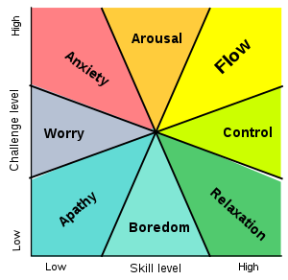
Flow Theory
Mihaly Csikszentmihalyi

Slide 21
Flow State
Intense and focused concentration on the present moment
Merging of action and awareness
A loss of reflective self-consciousness
A sense of personal control or agency over the situation or activity
A distortion of temporal experience, as one's subjective experience of time is altered
Experience of the activity as intrinsically rewarding, also referred to as autotelic experience

Slide 22
Achieving Flow
The flow state is an optimal state of intrinsic motivation, where a person is fully immersed in their activity.
  There are clear goals every step of the way.
  There is immediate feedback to one’s actions.
  There is a balance between challenges and skills.
  Action and awareness are merged.
  Distractions are excluded from consciousness.
  There is no worry of failure.
  Self-consciousness disappears.
  The sense of time becomes distorted.
  The activity becomes an end in itself.

Slide 23
The power of a project manager
A project manager must have power to do their job.
Managers must understand the types of power they have
Some power is better to use than others
Power that builds trust, respect and affirms people is best

Slide 24
Types of Power
Power is the potential to influence behavior to get people to do things they otherwise would not do.
Types of power include:
  Legitimate
    The ability to claim legitimate power as a reason to earn support. “Do it because I am your boss”
  Coercive/Penalty
    The ability to gain support through the use of force, threats or fear
  Reward
    Ability to gain support because subordinates perceive someone as being capable or directly or indirectly dispensing valued organizational rewards (e.g. salary adjustments, promotion, bonus, future work assignments, etc)
  Expert
    The ability to gain support because of superior knowledge, skills, or understanding of the problem or situation.
  Referent
    Ability to gain support because people feel personally attracted to the manager

Slide 25
Thamhain & Wilemon’s ways to have Influence and Power on projects
Authority: The legitimate hierarchical right to issue orders.
Assignment: The project manager's perceived ability to influence a worker's later work assignments.
Budget: The project manager's perceived ability to authorize others' use of discretionary funds.
Promotion: The ability to improve a worker's position.
Money: The ability to increase a worker's pay and benefits.
Penalty: The project manager's ability to cause punishment.
Work challenge: The ability to assign work that capitalizes on a worker's enjoyment of doing a particular task.
Expertise: The project manager's perceived special knowledge that others deem important.
Friendship: The ability to establish friendly personal relationships between the project manager and others.

Slide 26
Using Power for Success
Projects are more likely to succeed when project managers influence people using:
  Expertise
  Work challenge
Projects are more likely to fail when project managers rely too heavily on:
  Authority
  Money
  Penalty

Slide 27
Human Resource Planning
Involves identifying and documenting project roles, responsibilities, and reporting relationships
Outputs include:
  Project organization charts
  Staffing management plan
  Responsibility assignment matrices
  Resource histograms

Slide 28
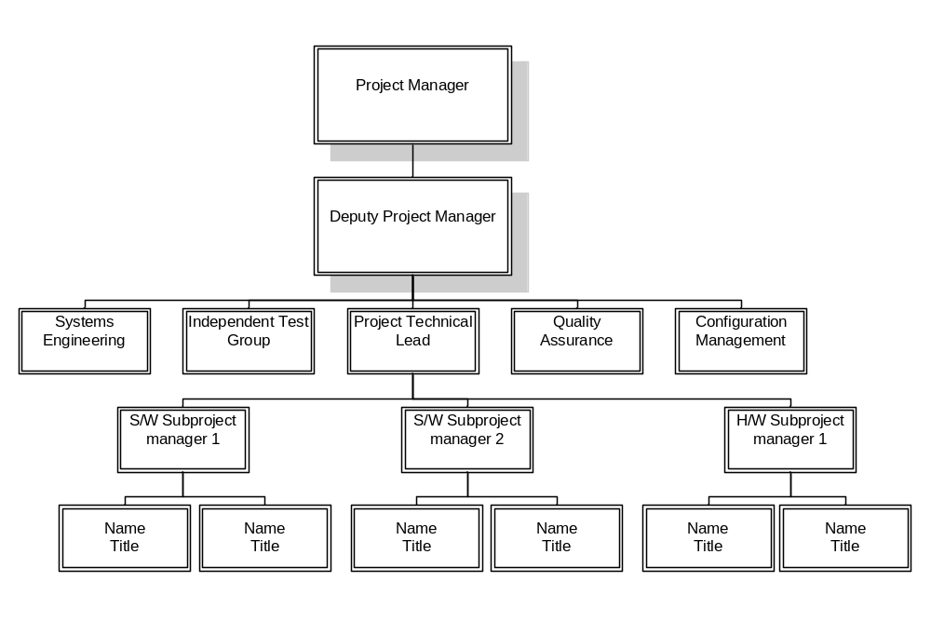
Sample Organization Chart

Slide 29
Responsibility Assignment Matrices
A responsibility assignment matrix (RAM) is a matrix that maps the work of the project as described in the work breakdown structure to the people responsible for performing the work.
It can be created in various ways to meet unique project needs.

Slide 30
Sample RAM
Tasks | Subtasks | SE | HA | SA | TR | User
A | System Design
A1 | Define work process | X |  |  |  | X
A2 | Identify required information and sources | X |  |  |  | X
A3 | Design software system to support work process
A31 | Basic software | X
A32 | Data access required | X |  |  |  | X
A33 | Vendor software required | X |  |  |  | X
A4 | Identify required hardware components | X |  |  |  | X
A0 | System design milestone | X |  |  |  | X
Key: SE System engineer personnel
HA Hardware acquisition
SA Software acquisition
TR Trainer

Slide 31
Staffing Management Plans
A staffing management plan describes when and how people will be added to and taken off the project team.
A resource histogram is a stacked column chart that shows the number of resources assigned to a project over time.

Slide 32
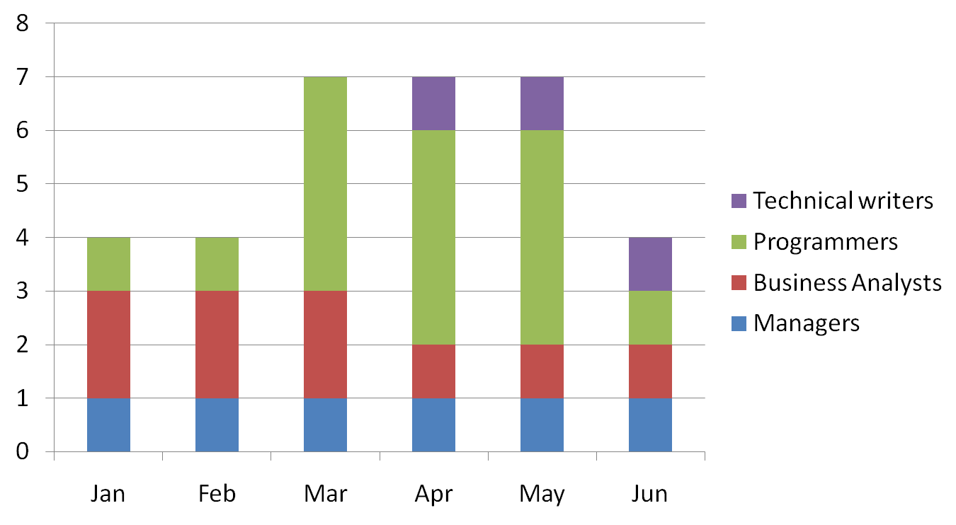
Sample Resource Histogram

Slide 33
Acquiring the project team
Acquiring qualified people for teams is crucial.
Staffing plans and good hiring procedures are important, as are incentives for recruiting and retention.
Why people leave their jobs
  They feel that they do not make a difference
  They do not get proper recognition
  They are not learning anything new or growing as a person
  They do not like their coworkers
  They want to earn more money

Slide 34
Training
Training can help people understand themselves and each other, and understand how to work better in teams.
Team building activities include:
  Physical challenges
  Psychological preference indicator tools

